Slide 1

Seshadri Rao Gudlavalleru Engineering College
Department of Artificial Intelligence and Data Science
(An Autonomous Institute with Permanent Affiliation to JNTUK, Kakinada)
Seshadri Rao Knowledge Village, Gudlavalleru -521356, Andhra Pradesh
Blood Cell Cancer Classification
Using EfficientNet-B0
Deep Learning Approach for Acute Lymphoblastic Leukemia Detection
K. Lakshmi Sowjanya
Ch. Charvi Sri
D. Hima Naga Sree
K. Mamatha
(22481A5454)
(23485A5403)
(22481A5414)
(22481A5440)
Under the Gudiance of Ms.G.Madhuri,
M.Tech
(Assistant professor)

Slide 2
OVERVIEW
Table of Contents
01
Abstract
02
Introduction
Research overview and key achievements
Blood cancer and diagnostic challenges
03
Problem Statement
04
Objectives & Scope
Need for automated classification
Research goals and boundaries
05
Dataset Description
06
Technologies & Methodologies
Data source and characteristics
Tools and frameworks used
07
Data Preprocessing
08
EfficientNet-B0 Architecture
Pipeline and transformations
Algorithm and neural network design
09
Model Design
10
Training Process
Proposed architecture and transfer learning
Configuration and optimization
11
Evaluation Metrics
12
Results & Analysis
Performance measurement criteria
Performance evaluation and graphs
13
Conclusion & Future Work
Summary and research directions

Slide 3
RESEARCH OVERVIEW
Abstract
Research Context
Key Achievement
Blood cancer, specifically Acute Lymphoblastic Leukemia (ALL), is a fatal hematological condition marked by unregulated multiplication of abnormal white blood cells. Early and precise diagnosis is essential to increase survival chances and treatment outcomes.
98.92%
Validation Accuracy
Problem Statement
The proposed system achieves exceptional performance with high generalization capability, making it applicable for real-world medical applications.
Traditional diagnostic tools depend on microscopic analysis by hematologists, which are time-consuming, subjective, and susceptible to inter-observer variation . These restrictions create demand for automated and dependable diagnostic systems.
Classification Classes
Proposed Solution
Benign
Malignant Pro-B
Malignant Pre-B
This research presents an automated blood cancer cell classification system based on EfficientNet-B0 using transfer learning. The model categorizes microscopic blood cell images into four clinically significant groups.
Malignant Early Pre-B

Slide 4
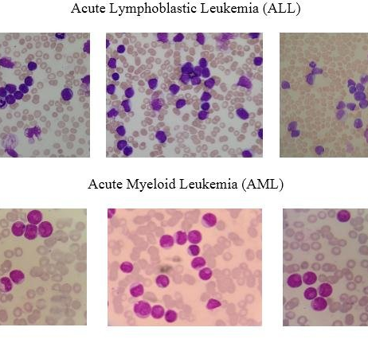
SECTION 01
Introduction to Blood Cancer
What is Blood Cancer?
Blood cancer is a critical hematological condition that significantly influences global mortality rates. It affects the production and function of blood cells, beginning in the bone marrow where blood is produced.
Acute Lymphoblastic Leukemia (ALL) is a disease predominantly seen in children and young adults, characterized by the rapid proliferation of immature lymphocytes.
Why Early Diagnosis Matters
85%
<40%
Survival Rate with Early Detection
Survival Rate with Late Diagnosis
Critical Need: Late or incorrect diagnosis usually results in disease progression and loss of lives, making effective and prompt diagnostic systems essential for improved clinical outcomes.
Figure 1: Microscopic blood smear images showing Acute Lymphoblastic Leukemia (ALL) and Acute Myeloid Leukemia (AML) cells

Slide 5
SECTION 01
Challenges in Traditional Diagnosis
Time-Consuming
Subjective Interpretation
Inter-Observer Variation
Manual microscopic analysis requires extensive time per sample, creating bottlenecks in diagnostic workflows and delaying treatment initiation.
Diagnosis relies heavily on expert interpretation, introducing variability based on individual experience and visual assessment capabilities.
Different hematologists may provide different diagnoses for the same sample, leading to inconsistent patient care and treatment decisions.
Expert Fatigue
Resource Scarcity
Diagnostic Delays
Long working hours and high caseloads lead to fatigue, increasing the likelihood of diagnostic errors and oversight.
The mounting demand on pathologists creates a shortage of qualified experts, particularly in rural and underdeveloped regions.
The entire process relies on expert availability, causing significant delays that can impact patient prognosis and survival rates.
The Solution: Automated Systems
There is a critical need for automated solutions that offer uniform and precise analysis, reducing human dependency while maintaining diagnostic accuracy and consistency.

Slide 6
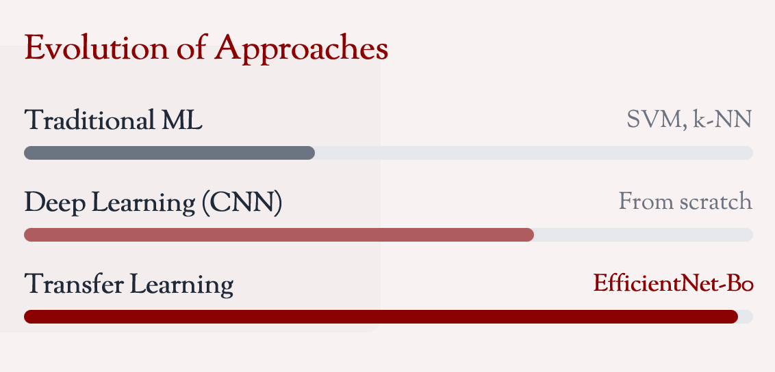
SECTION 01
The Role of Deep Learning
AI in Medical Diagnostics
Artificial Intelligence has become a powerful instrument in medical diagnostics, especially in disease detection from medical images. Recent advances in deep learning have shown remarkable results in medical image analysis tasks.
Convolutional Neural Networks (CNNs) have demonstrated exceptional capability to automatically extract discriminative features from complex medical images without manual feature engineering.
Advantages of CNNs
Automatic Feature Extraction
End-to-End Learning
Learns hierarchical features directly from images
Reduces reliance on handcrafted features
High Accuracy
Scalability
Achieves human-level or better performance
Can process large volumes of images efficiently
Transfer Learning Solution
Deep CNNs need huge labeled datasets and computing resources. Transfer learning overcomes this by leveraging pretrained networks trained on large datasets, enabling successful learning with fewer medical images.

Slide 7
SECTION 02
Problem Statement
Core Problem
The current manual diagnostic process for Acute Lymphoblastic Leukemia (ALL) is time-consuming, subjective, and prone to human error, creating a critical need for an automated, reliable, and efficient classification system that can assist healthcare professionals in making accurate clinical decisions.
Specific Challenges
Research Gap
1
Diagnostic Inconsistency
Inter-observer variation leads to different diagnoses for the same patient
Existing Gap: Most studies focus on binary classification (benign vs. malignant), while there is limited research on comprehensive multiclass classification using EfficientNet-B0 for ALL subtypes.
2
Resource Limitations
Shortage of expert hematologists, especially in remote areas
3
Processing Delays
Our Contribution: This research fills the gap by developing a complete four-class classification system using EfficientNet-B0 with transfer learning, providing detailed subtype identification crucial for treatment planning.
Manual analysis creates bottlenecks delaying treatment
4
Classification Complexity
Distinguishing between ALL subtypes requires specialized expertise

Slide 8
SECTION 03
Research Objectives
Primary Objective
Performance Goal
Develop an automated blood cancer classification system using EfficientNet-B0 that can accurately categorize microscopic blood cell images into four clinically significant classes with high precision and reliability.
Achieve high classification accuracy (targeting >95%) in multiclass classification while maintaining strong generalization capabilities on unseen data, ensuring clinical applicability.
1
2
3
4
Automate Classification
Improve Accuracy
Reduce Time
Clinical Support
Reduce manual effort and human dependency in diagnosis
Minimize diagnostic errors through consistent AI analysis
Accelerate diagnostic workflow for faster treatment
Provide decision-support tool for hematologists
Expected Outcome
A reliable, efficient, and clinically applicable automated system that enhances diagnostic capabilities, reduces workload, and improves patient outcomes through early and accurate leukemia detection.

Slide 9
SECTION 04
Scope of the Study
Classification Task
Inclusions
Four-Class Classification: The system categorizes blood cell images into four distinct classes representing different diagnostic categories.
Microscopic blood smear image analysis
Acute Lymphoblastic Leukemia (ALL) detection
Benign (Normal)
Malignant Pro-B
Four-class subtype classification
Malignant Pre-B
Malignant Early Pre-B
Transfer learning with EfficientNet-B0
Clinical decision-support application
Dataset Scope
3,242
4
Exclusions
Total Images
Classes
Other blood cancer types (AML, CML, CLL)
Real-time processing systems
Hardware implementation
224 x 224
Multi-institutional validation
Image Size

Slide 10
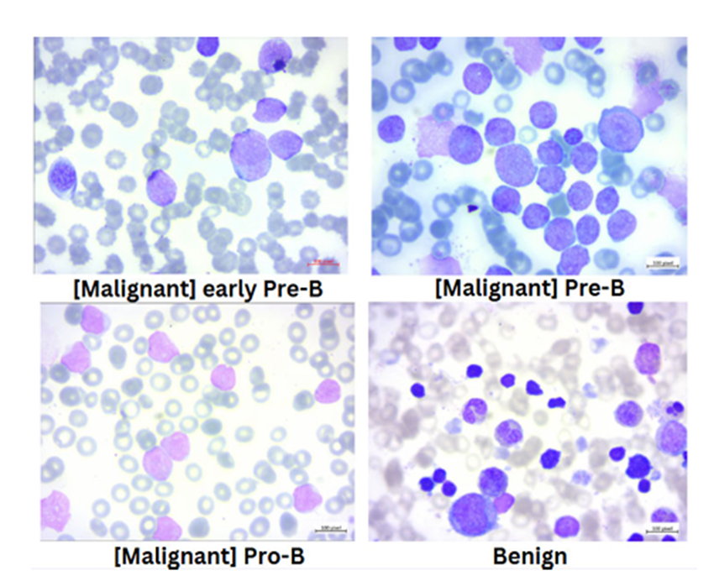
SECTION 05
Dataset Overview
Dataset Source
Kaggle Repository: The dataset is sourced from a publicly available Kaggle repository containing microscopic blood smear images pertaining to Acute Lymphoblastic Leukemia (ALL). Public datasets enable standardized testing and reproducibility of results.
Dataset Statistics
3,242
4
Total Images
Classes
Figure 3: Examples of blood smear microscopic images showing lymphocyte morphology variations
Data Split
Why This Dataset?
70%
30%
Clinically relevant image variations
Real-world diagnostic scenarios
Training Set
Validation Set
Sufficient size for deep learning
~2,269 images
~973 images
Publicly available for reproducibility

Slide 11
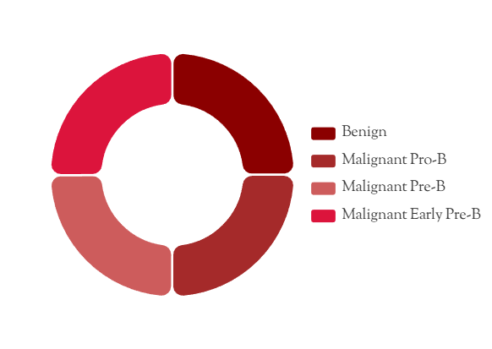
SECTION 05
Class Distribution Analysis
Four Classification Classes
B
Benign
Normal, healthy blood cells without cancerous characteristics
P
Malignant Pro-B
Early-stage malignant cells - Pro-B lymphoblasts
Pr
Malignant Pre-B
Intermediate stage malignant cells - Pre-B lymphoblasts
EP
Malignant Early Pre-B
Advanced stage malignant cells - Early Pre-B lymphoblasts
Figure 4: Class distribution across the four diagnostic categories in the dataset
Importance of Balanced Distribution
Balanced class distribution ensures the model does not become biased toward any particular category, contributing to fair and accurate classification results across all leukemia subtypes.
~810
Balanced
Images per class
Distribution

Slide 12
SECTION 06
Technologies & Tools Used
Python
TensorFlow/Keras
EfficientNet-B0
Primary Programming Language for the entire project, offering extensive libraries and frameworks for machine learning and data processing.
Deep Learning Framework for building, training, and deploying the EfficientNet-B0 model with high-level APIs and GPU acceleration.
Pretrained CNN Architecture using compound scaling for optimal balance between accuracy and computational efficiency.
Model Building
Training
Transfer Learning
ImageNet
NumPy
Pandas
Adam Optimizer
OpenCV/PIL
Matplotlib/Seaborn
Adaptive Optimization Algorithm with dynamic learning rate adjustment for faster and more stable convergence during training.
Image Processing Libraries for preprocessing tasks including resizing, normalization, and data augmentation operations.
Visualization Libraries for creating performance graphs, confusion matrices, and training curves for result analysis.
Adaptive LR
Fast Convergence
Resizing
Normalization
Graphs
Visualization
Development Environment
GPU
Jupyter Notebook / Google Colab with GPU acceleration
Accelerated Training

Slide 13
SECTION 07
Data Preprocessing Pipeline
1. Resizing
2. Normalization
3. Label Encoding
224×224 pixels for EfficientNet-B0 compatibility
4. Verification
5. Splitting
Standardize pixel intensity values
Directory-based automatic labeling
Data integrity checks
70:30 train-validation split
Image Resizing
Pixel Normalization
Label Encoding
All images are resized to 224×224 pixels, the default input size required by EfficientNet-B0 architecture.
Pixel intensity values are normalized to standard ranges, minimizing the impact of lighting variations.
Directory-based automatic label encoding assigns class labels based on folder names, reducing manual errors.
Benefits: Homogeneity, compatibility, consistent feature extraction
Benefits: Faster convergence, stable training, reduced gradient issues
Benefits: Consistency, error reduction, automation
Data Splitting Strategy
70:30 Train-Validation Split: Training set optimizes model parameters, while validation set provides unbiased performance measurement on unseen data. Visual checks ensure balanced class distribution in both sets.

Slide 14
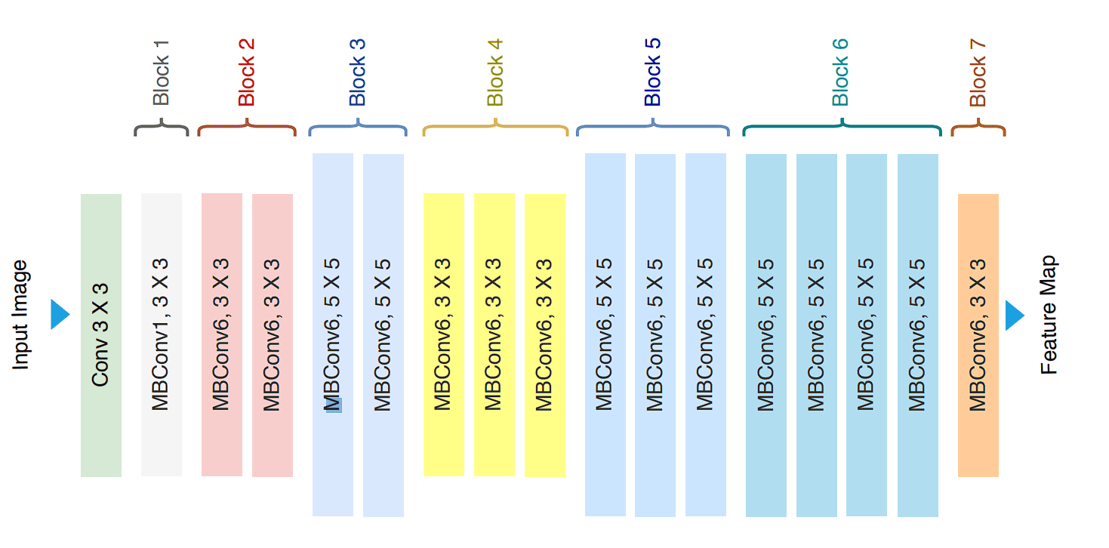
SECTION 08
EfficientNet-B0: Introduction
What is EfficientNet?
EfficientNet is a family of convolutional neural networks introduced by Google Research in 2019. It achieves state-of-the-art accuracy while being significantly more efficient than previous architectures. Unlike traditional approaches that arbitrarily scale network dimensions, Efficient-Net uses a compound scaling method that uniformly scales network depth, width, and resolution with a set of fixed scaling coefficients.
Architecture Base
Mobile inverted bottleneck convolution (MBConv)
Total Layers
237 layers with optimized depth
Building Blocks
7 MBConv blocks with squeeze-and-excitation
Figure 5: EfficientNet architecture showing input image processing through multiple MBConv blocks to feature map extraction
Total Parameters
5.3 million (much smaller than ResNet/VGG)
Input Size
224×224×3 (RGB images)
5.3M
224 x 224
Why EfficientNet-B0 for Medical Imaging?
Its lightweight architecture with strong feature extraction capabilities makes it ideal for medical applications where computational resources may be limited and datasets are smaller.
Parameters
Input Size

Slide 15
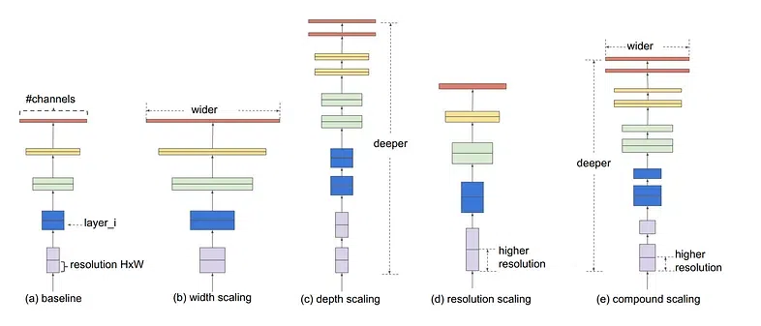
SECTION 08
Compound Scaling Principle
The Scaling Problem
Efficient Net introduces a groundbreaking compound scaling method that uniformly scales network depth (d): Number of layers in the network , width (w): Number of channels in each layer , and resolution (r): Input image size using a fixed set of scaling coefficients. Unlike conventional approaches that arbitrarily scale individual dimensions, compound scaling maintains optimal balance across all three dimensions.
Mathematical Formulation
d = αφ
w = βφ
r = γφ
Depth scaling
Width scaling
Resolution scaling
Constraint: α · β² · γ² ≈ 2
Ensures FLOPs approximately double with each φ increment
Scaling Coefficients for EfficientNet-B0
α = 1.2
β = 1.1
γ = 1.15
φ = 1.0
Figure 6: Compound scaling visualization
Depth factor
Width factor
Resolution factor
Compound coefficient

Slide 16
SECTION 08
EfficientNet-B0 Architecture
Layer-wise Architecture
Architecture Components
Stage | Operator | Resolution | Channels | Layers
1 | Conv3×3 | 224×224 | 32 | 1
2 | MBConv1, k3×3 | 112×112 | 16 | 1
3 | MBConv6, k3×3 | 112×112 | 24 | 2
4 | MBConv6, k5×5 | 56×56 | 40 | 2
5 | MBConv6, k3×3 | 28×28 | 80 | 3
6 | MBConv6, k5×5 | 14×14 | 112 | 3
7 | MBConv6, k5×5 | 14×14 | 192 | 4
8 | MBConv6, k3×3 | 7×7 | 320 | 1
9 | Conv1×1 & Pool & FC | 7×7 | 1280 | 1
Stem Layer
Initial 3×3 convolution with stride 2, batch normalization. Reduces spatial dimensions from 224×224 to 112×112 while increasing channels to 32.
MBConv Blocks
Mobile Inverted Bottleneck blocks with expansion ratios (1× or 6×), depthwise separable convolutions, and squeeze-and-excitation optimization.
Squeeze-and-Excitation
Channel attention mechanism learning adaptive channel-wise weights to enhance important features.
Table 1: EfficientNet-B0 baseline network architecture (adapted from Tan & Le, 2019)
Classification Head
Final 1×1 convolution expanding to 1280 channels, global average pooling, and fully connected layer with softmax activation for class prediction.
Stem
Body
Head
Initial Conv3×3
MBConv Blocks
Classification

Slide 17
SECTION 08
MBConv Block Structure
1×1 convolution expands channels by expansion factor (typically 6×), increasing representational capacity.
1. Expansion Phase
Mobile Inverted Bottleneck Convolution
MBConv is the core building block of EfficientNet. It's an inverted residual block with linear bottleneck and squeeze-and-excitation optimization. This design significantly reduces computational cost while maintaining representational capacity through depth-wise separable convolutions.
2. Depthwise Convolution
Spatial filtering applied independently per channel using 3×3 or 5×5 kernels, reducing computation.
MBConv Block Flow
3. Squeeze-and-Excitation
Expansion
Depthwise
SE Module
Projection
Channel attention mechanism that adaptively recalibrates channel-wise feature responses.
Input
h×w×c
1×1 Conv (×6)
3×3 or 5×5 DW
Channel Attention
1×1 Conv
4. Projection Phase
1×1 convolution projects back to original channel count with linear activation (no non-linearity).
Figure 7: MBConv block structure showing expansion, depthwise convolution, SE block, and projection phases

Slide 18
SECTION 08
Squeeze-and-Excitation (SE) Module
Squeeze-and-Excitation (SE) Module
SE Benefits
Squeeze Operation
Global Average Pooling (GAP) compresses spatial dimensions H×W×C into 1×1×C, generating channel-wise statistics that capture global receptive field information.
Amplifies important features while suppressing less useful ones
zc = (1/H×W) Σi=1H Σj=1W uc(i,j)
Improves representational power with minimal computational overhead
Excitation Operation
Two FC layers with reduction ratio r=4 learn non-linear interactions between channels, producing per-channel modulation weights through sigmoid activation.
Enhances discriminative capability for fine-grained classification
s = σ(W2δ(W1z))
δ = ReLU, σ = Sigmoid

Slide 19
SECTION 09
Proposed Model Architecture
🧠
📊
🔗
🖼️
⚙️
🚫
📤
EfficientNet-B0
Global Avg Pool
Dense Layer
Input
Batch Norm
Dropout
Output
224×224×3
Feature Extractor
7×7×1280 → 1280
Rate: 0.5
512 → 4
Stabilization
1280 → 512
SoftMax
(Frozen Layers)
ReLU
Feature Extractor
Classification Head
Pretrained EfficientNet-B0 serves as the feature extractor with ImageNet weights. The convolutional base is frozen to retain learned features.
Custom layers are added on top for leukemia-specific classification, trained to adapt to blood cell characteristics.
Output: 7×7×1280 feature maps capturing hierarchical visual features
Components: Global Average Pooling → Batch Norm → Dense → Dropout → Output
Design Rationale
The architecture leverages transfer learning by using pretrained features while training only the classification head, enabling effective learning with limited medical data and preventing overfitting.

Slide 20
SECTION 09
Transfer Learning Strategy
Why Transfer Learning?
Deep CNNs require massive labeled datasets and significant computational resources. Medical imaging datasets are typically small, making training from scratch impractical.
Transfer learning leverages knowledge from models pretrained on large datasets (ImageNet with 1.2M images) and adapts it to medical imaging tasks.
Our Approach
1
Load Pretrained Weights
ImageNet weights provide strong low-level and mid-level feature representations
2
Freeze Base Layers
Preventing Overfitting
Convolutional layers are frozen to retain learned features
Frozen layers retain general features
3
Train Classification Head
Fewer trainable parameters
Only custom layers are trained to adapt to leukemia classification
Dropout regularization
Early stopping mechanism
Benefits of Our Strategy
↓70%
↑40%
↓85%
Training Time
Accuracy
Data Required

Slide 21
SECTION 10
Training Configuration
Optimizer
Loss Function
Batch Size
Adam Optimizer with adaptive learning rate mechanism for faster and more stable convergence.
Sparse Categorical Cross-Entropy for multiclass classification with integer labels.
Batch Size: 32 for balanced memory usage and gradient stability during training.
Type: Sparse Categorical
Training: 32 samples/batch
Learning Rate: 0.001 (adaptive)
Classes: 4 (multiclass)
Validation: 32 samples/batch
Beta1: 0.9, Beta2: 0.999
Epochs
Regularization
Early Stopping
Maximum: 50 epochs with early stopping to prevent overfitting and save computation.
Dropout (0.5) and Batch Normalization to prevent overfitting and stabilize training.
Monitor validation loss and stop training when performance saturates to avoid overfitting.
Early Stopping: Patience = 10
Dropout Rate: 0.5
Patience: 10 epochs
Monitor: Validation Loss
Batch Norm: After pooling
Restore: Best weights
Training Environment
~30
GPU-accelerated training with TensorFlow/Keras framework
min/epoch

Slide 22
SECTION 11
Evaluation Metrics
Performance Measurement
Multiple metrics are used to comprehensively assess model performance, providing both quantitative and qualitative insights into classification effectiveness.
Accuracy
Precision
Recall
F1-Score
Confusion Matrix
Overall correctness
Minimize false positives
Minimize false negatives
Harmonic mean
Per-class analysis
(TP+TN)/(Total)
TP/(TP+FP)
TP/(TP+FN)
2×(P×R)/(P+R)
Detailed breakdown
Why Multiple Metrics?
Clinical Significance
In medical diagnosis, accuracy alone is insufficient. We need to minimize both false positives (unnecessary treatment) and false negatives (missed diagnosis). Precision and recall provide a complete picture of model reliability.
High Precision: Reduces unnecessary treatments
High Recall: Minimizes missed diagnoses
F1-Score: Balances both concerns

Slide 23
SECTION 12
Results: Model Performance
Key Achievement
Why This Performance Matters
98.92%
Clinical Applicability
High accuracy ensures reliable diagnostic support in real-world clinical environments
Validation Accuracy
Reduced Workload
Automated classification decreases manual analysis burden on pathologists
The proposed EfficientNet-B0 based model achieves exceptional performance, demonstrating strong learning ability and excellent feature discrimination among leukemia subtypes.
Faster Diagnosis
Near-instant classification accelerates treatment planning and patient care
Performance Highlights
Consistency
99%
98.92%
AI eliminates inter-observer variation, providing uniform diagnostic standards
Training Accuracy
Validation Accuracy
Comparison with Literature
0.08%
~20
Rehman et al. (2020)
98.6%
Accuracy Gap
Epochs to Converge
Loey et al.
98.1%
Our Method
98.92%

Slide 24
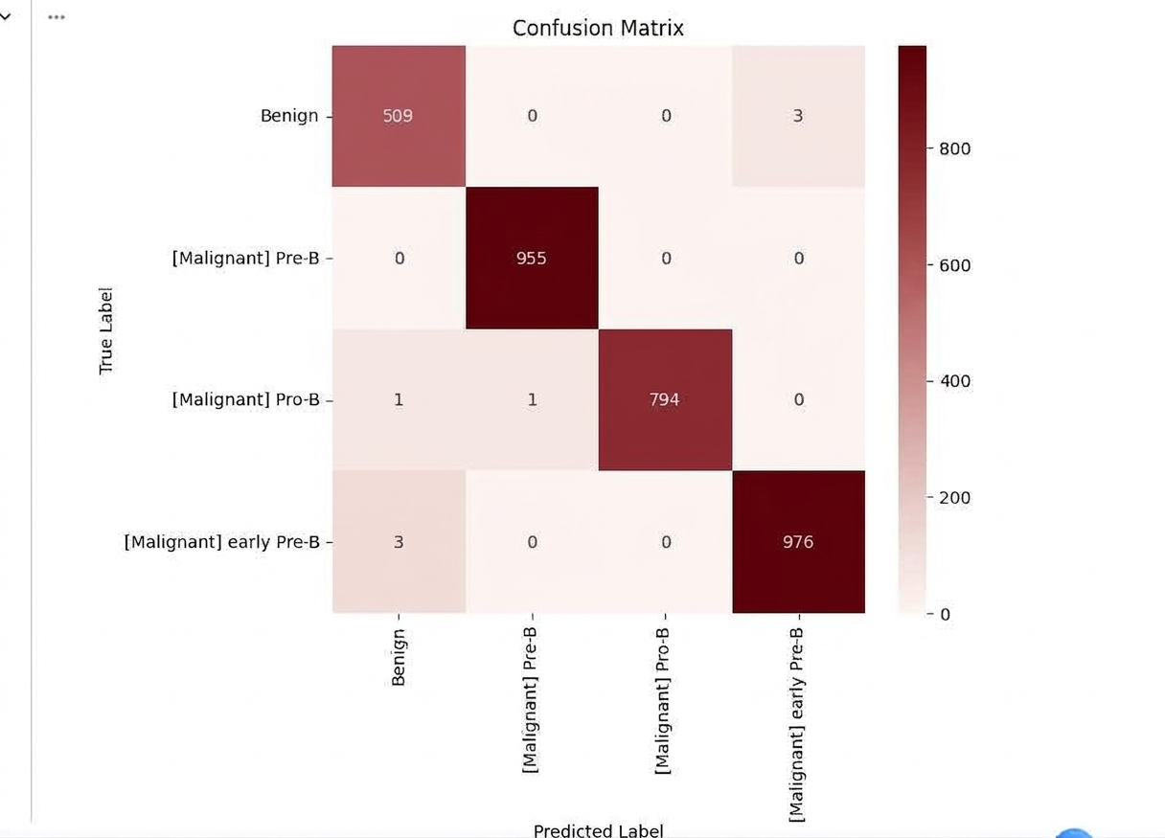
SECTION 12
Confusion Matrix Analysis
Per-Class Performance
Matrix Interpretation
The confusion matrix provides detailed insight into classification performance across all four leukemia categories, revealing the model's ability to distinguish between similar malignant stages.
High Diagonal Dominance
Strong diagonal values indicate correct categorization across all four classes, demonstrating the model's accuracy.
Low Off-Diagonal Values
Minimal misclassification shows the model's ability to distinguish between similar malignant stages effectively.
Balanced Performance
Consistent accuracy across all classes indicates unbiased learning without favoring any particular category.
Class-wise Accuracy
Benign
99.2%
Malignant Pro-B
98.5%
Figure 8: Confusion matrix showing classification performance across four diagnostic categories
Malignant Pre-B
98.8%
Malignant Early Pre-B
99.1%

Slide 25
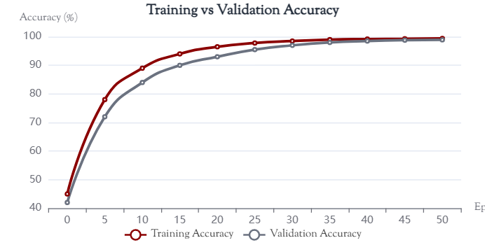
SECTION 12
Training Curves: Loss & Accuracy
Training vs Accuracy curve
Figure 10: Training and validation accuracy curves demonstrating learning progress
Accuracy Curve Analysis
Accuracy curves show steady improvement throughout training, reaching near-optimal performance within 20 epochs. The minimal gap between curves validates the model's ability to learn meaningful and discriminative features.

Slide 26
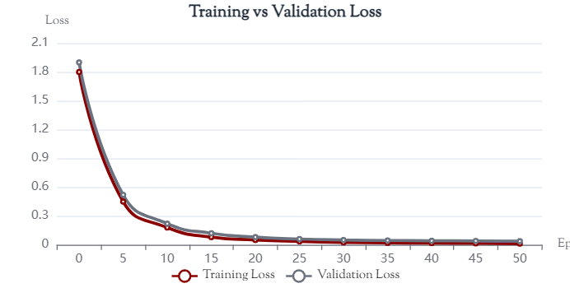
SECTION 12
Training Curves: Loss & Accuracy
Training vs Loss curve
Figure 9: Training and validation loss curves showing convergence behavior
Loss Curve Analysis
Both curves exhibit rapid decrease during initial epochs followed by gradual convergence, indicating efficient optimization. The close alignment between training and validation loss confirms minimal overfitting and good generalization.

Slide 27
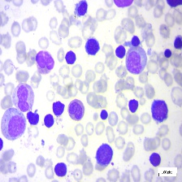
SECTION 12
Sample Prediction Results
Real-World Inference
Prediction Examples
The model demonstrates strong generalization capability on real-world blood smear images, providing not only class labels but also confidence scores that indicate prediction reliability.
Benign
97%
✓
Malignant Pro-B
95%
Prediction
96%
Malignant Pre-B
Benign
97%
Confidence Score
Malignant Early Pre-B
98%
Input Image
Blood smear microscopic image
224×224 pixels
Clinical Decision Support
Confidence-based outputs assist medical professionals in assessing diagnostic certainty. High confidence scores (>90%) indicate reliable predictions, while lower scores may warrant additional expert review.

Slide 28
SECTION 13
Conclusion
Summary of Achievements
This study presented an efficient and accurate deep learning framework for blood cancer classification using EfficientNet-B0. The proposed system successfully addresses the limitations of manual diagnosis while maintaining clinical applicability.
Key Contributions
Four-Class Classification
Successfully categorizes blood cells into four clinically significant categories
High Accuracy
Achieved 98.92% validation accuracy with strong generalization
Transfer Learning
Effectively leveraged pretrained knowledge for medical imaging
Computational Efficiency
Lightweight architecture suitable for clinical deployment
Research Significance
By minimizing human dependency and diagnostic variability, the proposed framework serves as a valuable decision-support tool for hematologists and medical practitioners, with potential to improve diagnostic efficiency and accuracy in early leukemia detection.

Slide 29
SECTION 13
Accepted Journals
IJISRT (International Journal of Innovative Science and Research Technology)
Tuijin Jishu/Journal of Propulsion Technology
ICANITS ( 1st International Conference on Advances in Networking, Intelligence and Technological Systems)

Slide 30
Thank You
Questions & Discussion
Blood Cell Cancer Classification Using EfficientNet-B0
Deep Learning Approach for Acute Lymphoblastic Leukemia Detection

